Slide 1


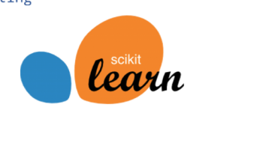
Diabetes Detector
Web Application
-Using Machine Learning

